Slide 1

Making a splash in the NBA

Slide 2
Introduction
NBA commissioner Adam Silver has accepted the Vancouver Whales proposal as the new expansion team for the 2021 season.
Stipulations:
No protected players, all players are available
Player’s salary will be equivale to last year’s salary
Only one starter and bench player for each position

Slide 3
Team Proposal
Elon Musk, the owner of the Vancouver whales, wants to assemble a winning team for the 2021 season. He has hired Lucy Luo, Ryan Worm, and Tom Nierodzik to assemble multiple rosters based on different goals.
Championship contender:
The average number of wins required to get first place (regular season) is 67 wins based off the last five years.
Playoff contender:
The average number of wins required to get sixteenth place (last playoff position) is 41 wins over the last five years.

Slide 4
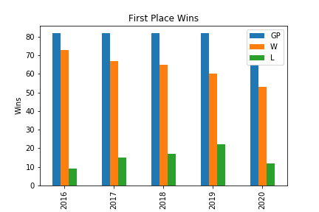
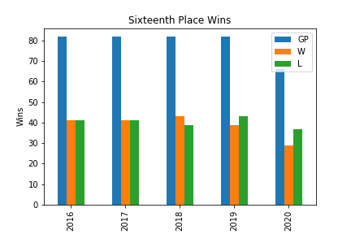
Qualifying success
Notes:
* Replace bar graphs -

Slide 5
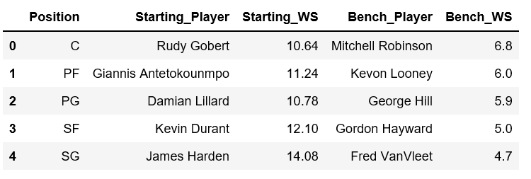
The Dream Team
Built to dominate the league now, this roster has the highest win share per position by top WS (Win Share) per position over the last five years. WS is a metric that estimates how many wins that player contributes individually over the course of a season.

Slide 6
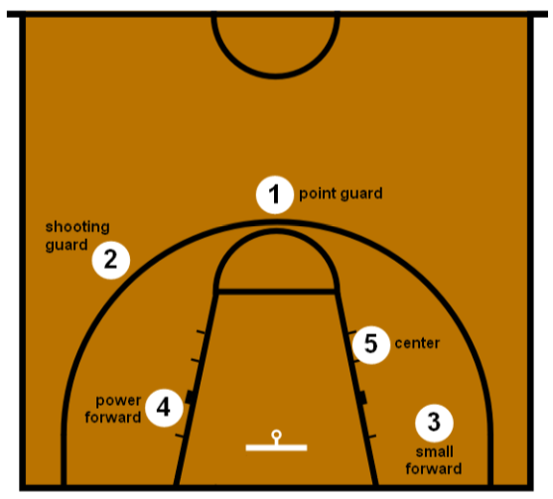
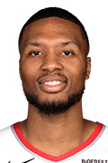
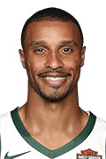
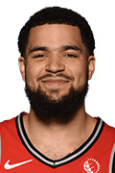
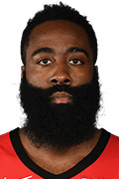
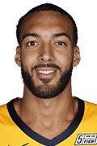
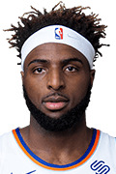
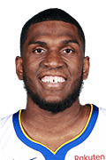
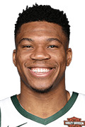
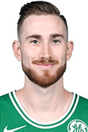
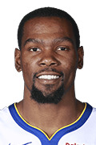
Basketball Positions
STARTER
BENCH
BENCH
STARTER
STARTER
BENCH
BENCH
STARTER
BENCH
STARTER

Slide 7
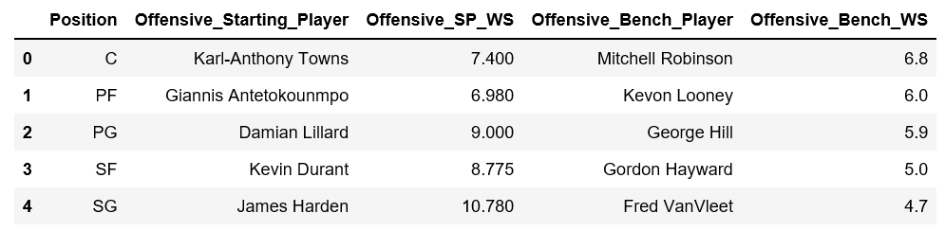
Offence, Offence, Offence
Aiming to cut cost on defence, this roster is built to dominate offensively. This roster is made up of the top five players ranked by Offensive Win Shares (OWS). OWS measures the offensive contributions that player brings to their team as wins over the course of a regular season.

Slide 8
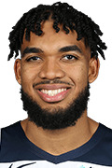
Basketball Positions
STARTER
BENCH
BENCH
STARTER
STARTER
BENCH
BENCH
STARTER
BENCH
STARTER

Slide 9
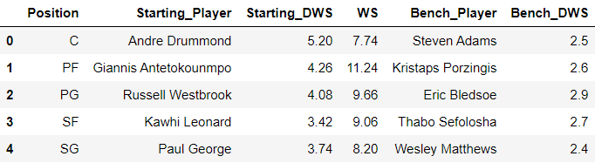
Defensive Powerhouse
The counter to the offensive-focused team, this team is built to cut cost on offense and win games playing shut down basketball. This roster is built by selecting the top five players by Defensive Win Shares (DWS). DWS measures the defensive contributions that player brings to their team as wins over the course of a regular season.

Slide 10
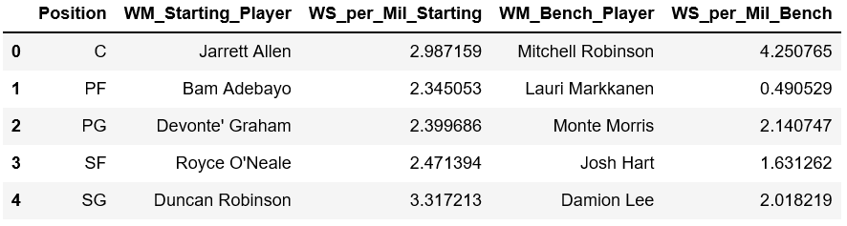
Money Ballers
Built on the most team-friendly contract the league has to offer. This team is built by selecting the top players ranked by Win Shares/ ($) Million.

Slide 11
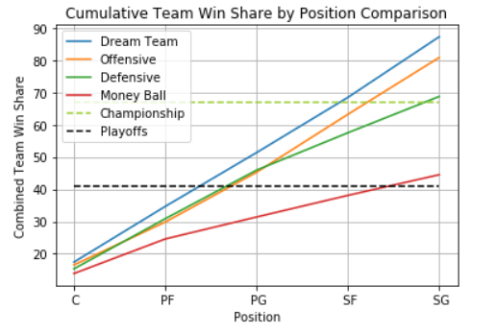
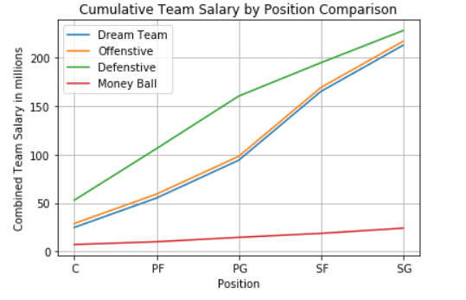
Notes:
{sample} “Before we go into our recommendations, lets look at where the teams stack up in total wins. As you can see, our money ball team is already making the playoffs at a fraction of a cost of our other assembled rosters.

Slide 12
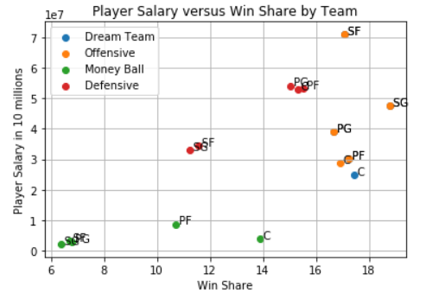
Notes:
If we look at win share/ million dollars, we can see that there are a couple extremely undervalued players, most notably at the PF and C position.

Slide 13
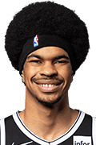
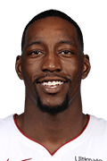
The sleepers
Center: Jarrett Allen
Power Forward: Bam Adebayo
Notes:
Bam Adebayo and Jarret Allen are extremely valuable players at a fraction of the cost of their more notable counterparts.

Slide 14
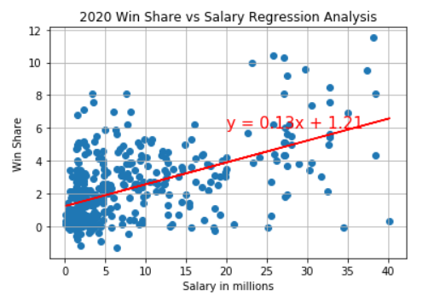
Notes:
We recommend building a team around these two players and then using the savings to spend on more productive SF, SG and PW. Given the cost of defensive superstars we are suggest increased weight placed on offensive production, although we do not recommend signing any player with a negative DWS.

Slide 15
Opening the wallet
Shooting Guard: James Harden
Point Guard: Damian Lillard
Small Forward: Kevin Durant

Slide 16
Recommendations and findings:
Based on the data gathered, we think that it would be most cost effective to build a competitive team based on WS/($) Million.
This roster would likely make the playoffs and be able to compete for the championship while costing far less then the performance driven rosters.

